Slide 1
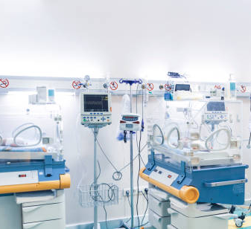
Integrating Tissue Adhesive in
Your
Bundle
Mitigating Vascular Access Complications in NICU |
Notes:
LORI to intro and housekeeping items
include a discussion/mention of TA data being published for all populations then ... this webinar will focus on how TA for the NICU population.

Slide 2
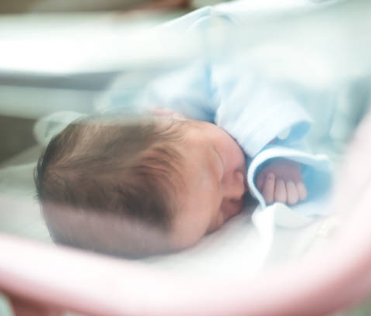
Amy Paradis,
NNP-BC, MS, CNS
Amy has been an NNP
and CNS at Doctors Medical Center Modesto since 2005. She had the great honor of working with her mentor Janet Pettit and began her career in the Neonatal ICU as a new grad RN in 1990.

Slide 3
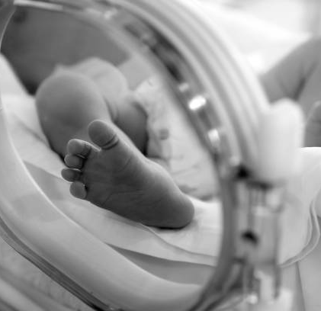
Disclosures
Prolacta Bioscience, Consultant
Argon Medical Devices, Consultant
PDI, Grant/Travel Support
Adhezion Biomedical, LLC, Speaker
No off-label product use will be discussed.

Slide 4


Average daily census: 22 babies
35 bed Community Level III NICU
379 admissions in 2022
~40 PICCs central lines
~ 55 Umbilical lines
Notes:
At Doctors Medical Center, the average daily census is 22 babies
This is a 35 bed Community Level III NICU
With 379 admissions in 2022 and about
~40 PICCs central lines and
~ 55 Umbilical lines placed last year.

Slide 5
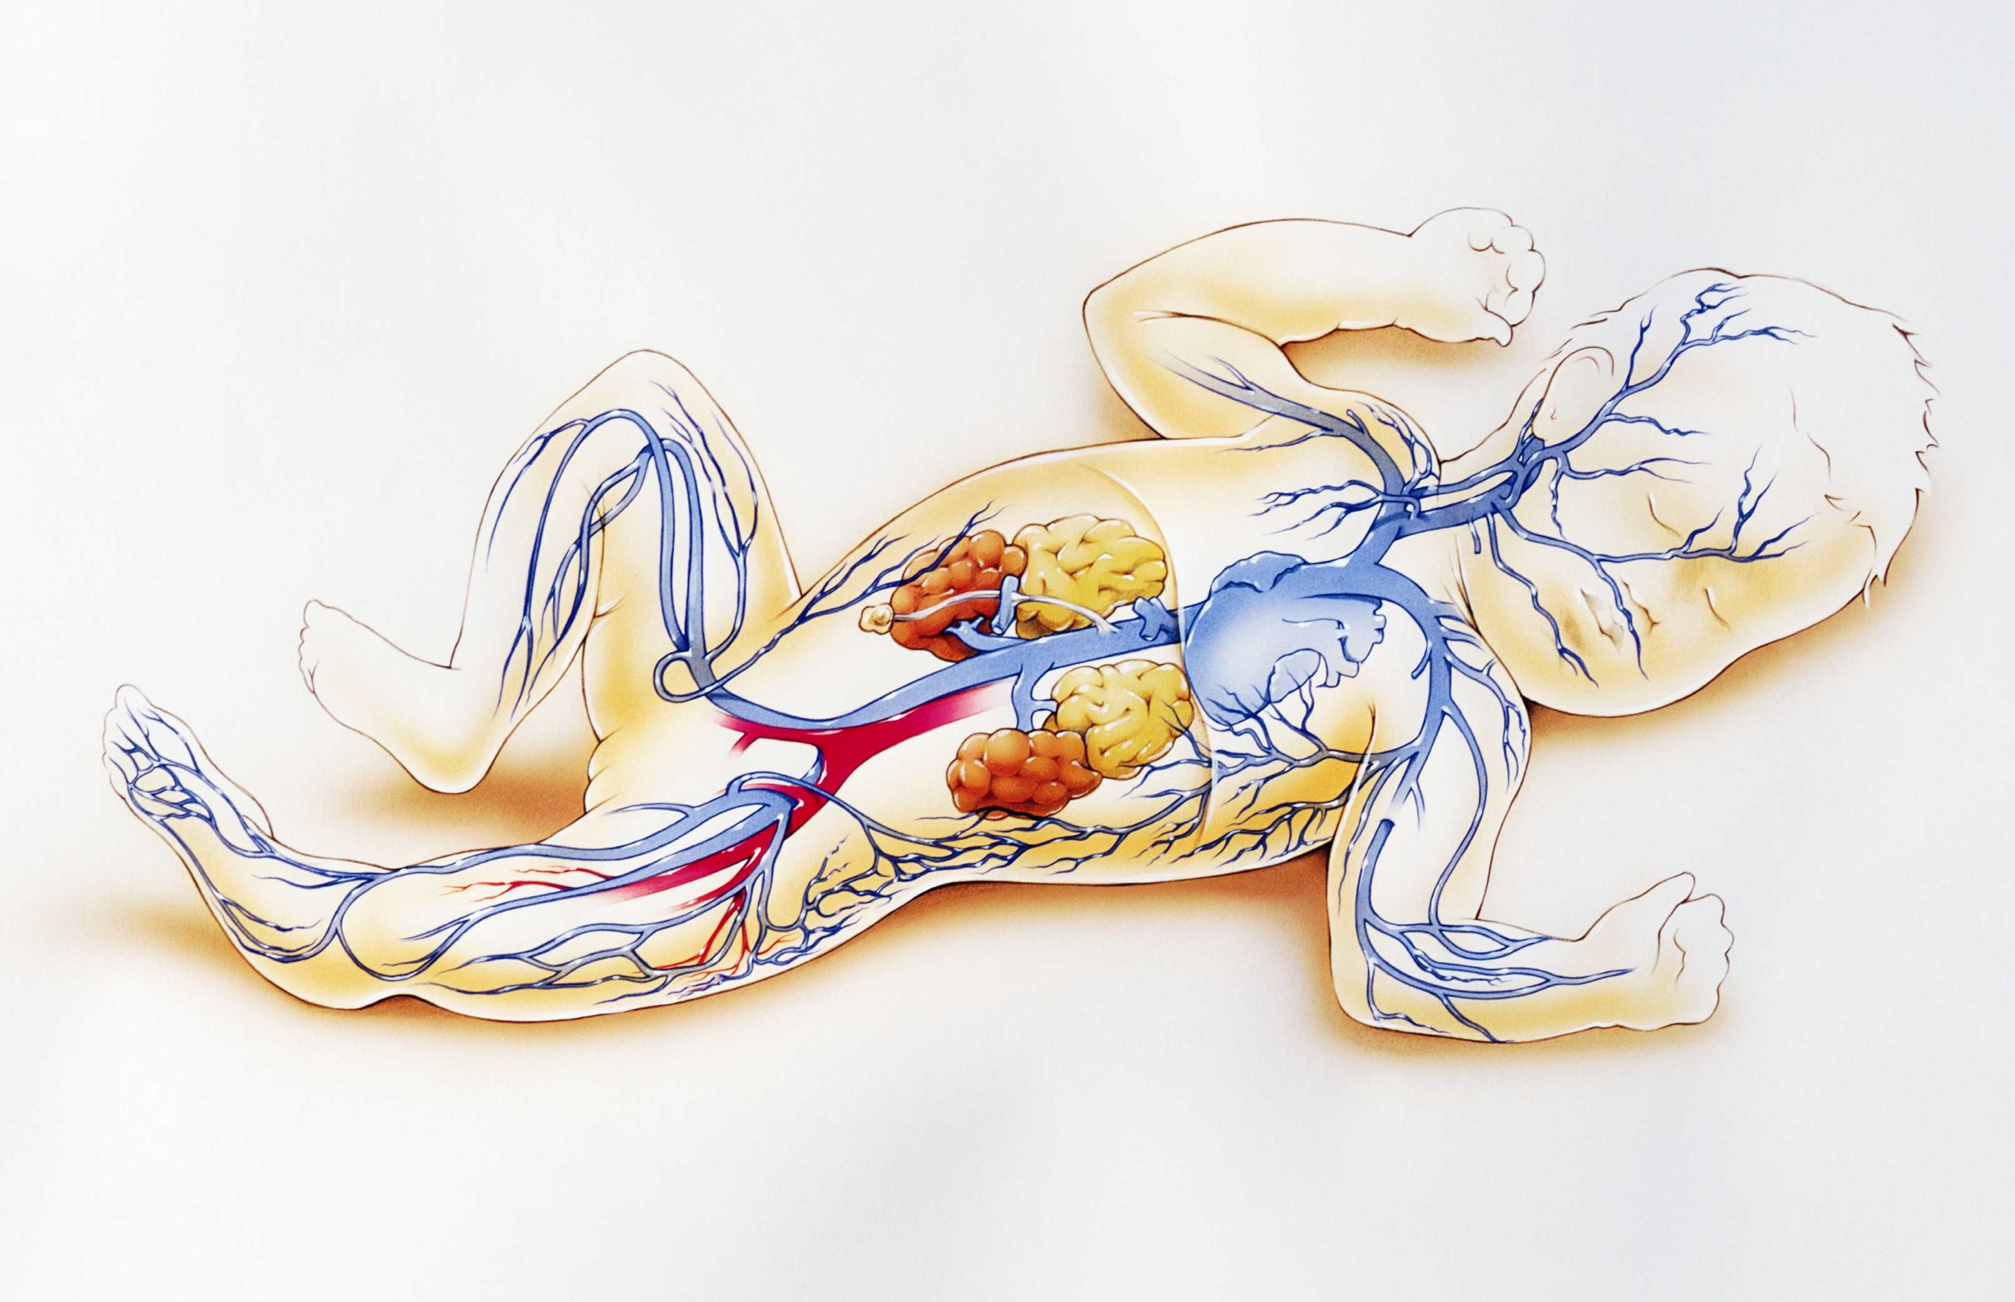
Polling Questions??
Do you use TA in your NICU?
If so:
  PICCs
  Midlines
  PIVs
  Umbilical lines
Do you reapply TA with dressing changes?

Slide 6
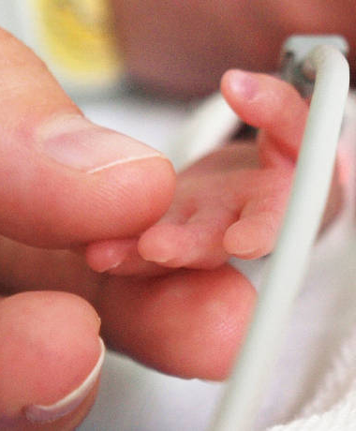
Objectives
Describe cyanoacrylate securement adhesive
Discuss neonatal vascular access standards and guidelines for securement, infection protection, and skin integrity.
Examine data and evidence supporting the use of cyanoacrylate tissue adhesive in the neonatal population.
Explore risk factors for vascular access-related bloodstream infections in neonates
Review bundle practices used to improve vascular access safety and reduce vascular access complications in the neonate
Discuss neonatal case studies using tissue adhesive

Slide 7
What is Cyanoacrylate Tissue Adhesive (TA)?
Often referred to as “GLUE”
Liquid monomer upon exposure to moisture and exothermic process releasing energy as molecules come together
Used as tissue closure for surgical procedures and wound closures as alternative to sutures
Early use of cyanoacrylates go back to 1950s
Vascular access preparation is different, no immediate bonding, more ”tacky” feel on the skin, immediately water-resistant, more flexible higher tensile strength

Slide 8
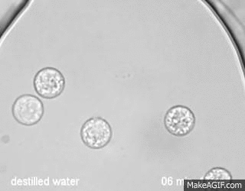
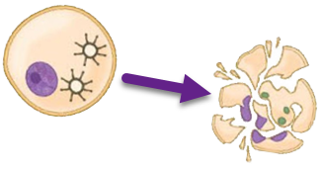
2-octyl cyanoacrylate (80%) butyl cyanoacrylate
Low water activity is a limiting factor for microbial survival
Completely kills >/= 8 log of bacteria after a 3-minute contact time
Broad spectrum:
Gram –, Gram +, Yeast, Fungi
Water diffusion from microbe cell into CA causes cell lysis and death
(Prince et al., 2017)

Slide 9




Impact of Cyanoacrylate Adhesive Securement
Seals the insertion site
Provides Hemostasis
CLABSI Reduction
Immobilize Pathogens
8-log reduction
Broad Spectrum
Gram – , Gram + Yeast and Fungi
Catheter securement
Improve dressing adherence
Notes:
8 log reduction: for example CHG 4-log (100 microbes remain) vs 6-log hand sanitizers (10 microrbes remain) 8-log 99.9999% reduction (less than one microbe)
Seal the site
Stop bleeding 12 fold faster than thromboplastin
decrease dressing changes
Significantly decrease CA-BSI
Dressing adherence
Unscheduled dressing changes lead to misadventures
Decrease need to replace dressing after hemostatisis and removal of hemostatic agents at insertion site
Bleeding and oozing
Microbial barrier
> 8 log reduction

Slide 10

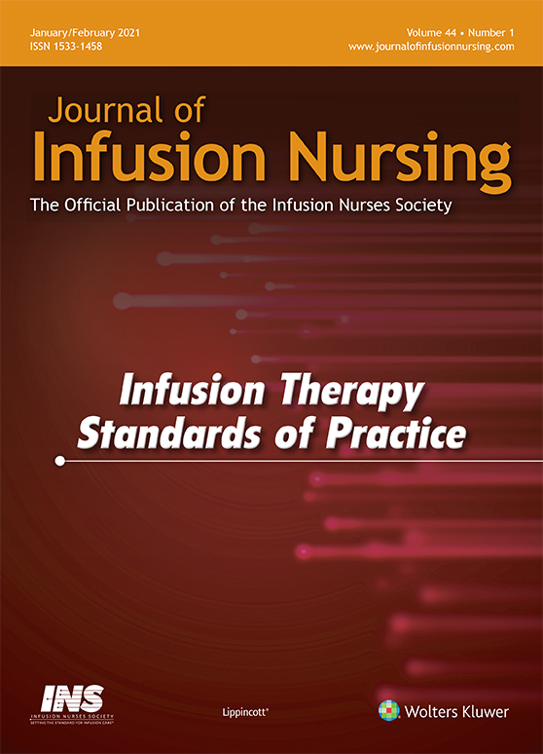

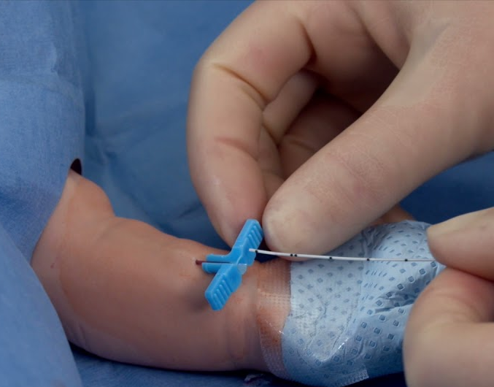




Standards and Guidelines
PediNeoSIG
Guidelines
(in development)
Notes:
NANN: 4th edition 2021, mention of TA as securement and prevention of migration
INS 8th ed 2021: #38 VA device securement and #42 VA device assess, care and dressing changes
AVA: 2021 Intravascular Quarterly May 2021
FDA approval for all types of VA, no age restriction and safe on PU and SI caths

Slide 11
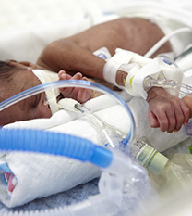
Cyanoacrylate Securement in Neonatal PICC Use
A 4-Year Observational Study of 1,842 Successful PICC insertions
The most frequently reported complication was suspected sepsis. The risk for complication was increased in participants with no TA applied for catheter securement.
TA demonstrated 44% reduction in risk of therapy failure
65% CLABSI reduction in TA group
  2.76/1000 days in non-TA group vs. 0.99/1000 days in TA group ( P < .001)
Notes:
Large tertiary NICU in Qatar
Large number of ELBW babes
77% in lower extrem

Slide 12
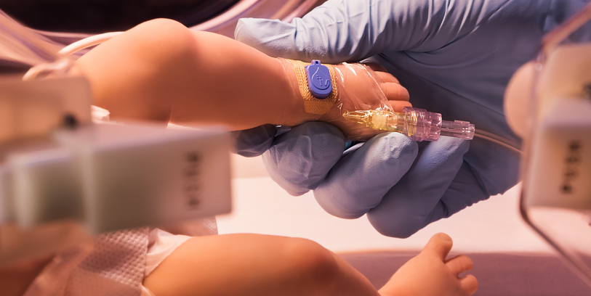

Multimodal Approach to Reducing PIVC Complications
Premature
Removal ⬇️ 25%
Phlebitis⬇️77%
12-month observational study
8,330 PIVC in NICU
Dwell
Time
⬆️
20%
Tissue Adhesive
Biosensor Monitoring Technology
Van Rens, et al., 2023
Notes:
Retrospective Observational study
Single NICU
6month before and 6mons after initiation of TA
Insertion and Monitored by NICU VAT team
ivWatch technology

Slide 13
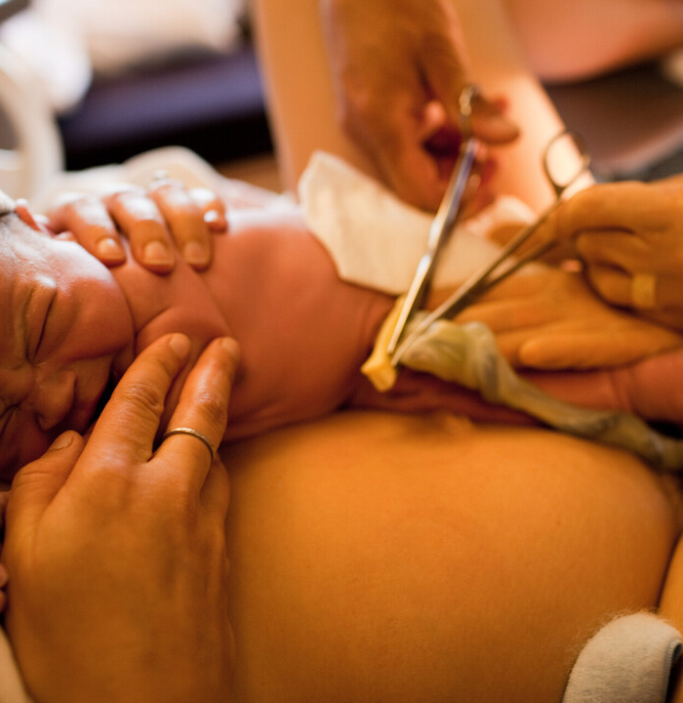
Umbilical Catheter RCT
Single-Center RCT
non-blinded
Intervention: Cyanoacrylate (CA) + Suture (n=130)
Sutures alone have higher dislodgement rate
Cyanoacrylate (CA) tissue adhesive (TA) has been shown to be safe and effective for other neonate catheters including CVC and peripheral catheter (PIVC)
This is the first study to investigate the use of CA TA for the securement of UVCs
Safe and effective for UVC
Cyanoacrylate glue was safe and effective for securement of UVCs and particularly effective in reducing early dislodgments.
Dislodgement rate 23.1% (suture only) compared to 1.5% suture + CA TA in first 48 hours after insertion
Overall dislodgement 24.6% vs 7.7% in TA group

Slide 14
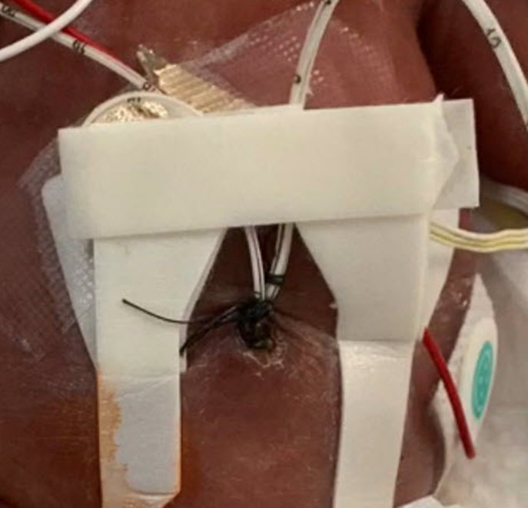
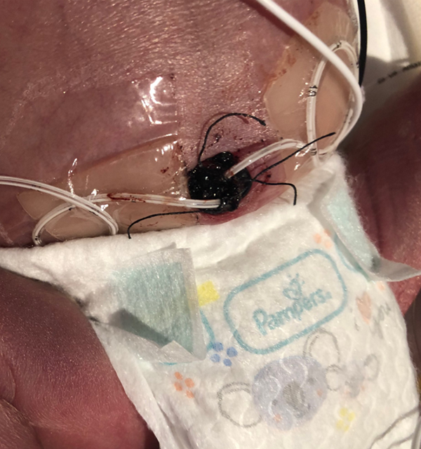
Umbilical Catheter Securement with Tissue Adhesive Added
Suture catheter(s) per facility protocol and stabilize external tubing
Obtain post-placement x-ray per facility protocol and make necessary line adjustments
Obtain hemostasis to the degree possible before TA is applied
Apply 1 drop TA to the insertion and suture area of each catheter entry point
It is recommended to reapply 1 drop of TA at the insertion point of the remaining catheter entry site if the second catheter is removed or on the 5th dwell day for continued maintenance of the exit point seal
At the time of device removal, remove the catheter(s) per facility protocol. Withdraw the catheters as you usually would. Use a light back-and-forth rocking motion at the stump to loosen the seal if needed
Residual TA will naturally slough off
Before Tissue Adhesive
After Tissue Adhesive

Slide 15


Tissue Adhesive Removal
Paper published in Frontiers in Pediatrics
AWHONN Skincare Guidelines do not address topic yet
Allowing time as skin cells replicate and replenish
Gentle tug to ”release” TA
Avoid solvents on newborn skin
Consider use of silicone-based adhesive remover
Caution on use during sterile procedure or dressing changes

Slide 16
Do We Have Time To Reduce BSIs?
Alcohol Hand Gel 10 SECONDS
Maximum Sterile Barriers 40 SECONDS
Apply CHG 30 SECONDS
CHG Dry Time 30 SECONDS
Tissue Adhesive 10 SECONDS
Notes:
TWO MINUTES

Slide 17

Practice
Bundles
Notes:
AMY
Slide 6
Bundles of proven practices have become a popular means for ensuring each patient receives the appropriate care for prevention of CLABSI, based on current evidence. The bundle items listed here depict the required elements for the insertion of a central line with most being commonly employed in the NICU. The last item listed promotes the use of CHG/alcohol for skin antisepsis for the procedure, which is an evolving practice in neonates. However, CHG is the standard for adults and children due to a 49% reduction in CRBSI when compared to povidone iodine.

Slide 18
Insertion
Performance Expectations | Considerations
Insertion
1. Maximum sterile barrier precautions utilized for all central line insertions | -Cover entire infant with sterile drapes or as much as affords safe observation. -Those performing insertion will wear hair covering, face mask, sterile gown and sterile gloves. - Staff wear face mask when within 3 feet of sterile field.
2. Skin disinfected with alcohol-based Chlorhexidine (CHG) if greater than1000 grams or 1 week of age or povidone iodine (PI) when CHG can’t be used. | -Apply over 30 seconds & allow to dry -Povidone iodine to be removed from the skin following procedure.
3. Dedicated team for placement & maintenance. | -Physicians and nurse practitioners place central catheters.
4. All supplies required for the procedure should be available at the bedside prior to catheter insertion. | -Procedure carts used for central line insertion contain all supplies for the procedure
5. Hand hygiene standards met | -Hand hygiene performed using alcohol gel or antiseptic soap and water prior to the procedure.
6. Central Line Insertion Practices (CLIP) Insertion checklist utilized, per State of California requirement. | -RN assisting with monitoring during the procedure ensures the sterile field hasn’t been breeched.
7. Staff empowered to stop non-emergent procedure if sterile technique not followed.
Notes:
AMY

Slide 19
Maintenance
Maintenance | Considerations
Assessment & Site Care
1. Daily assessment and documentation of catheter need by MD or NP included in patient progress note. | When catheter used primarily for nutritional purposes: -Consider removal when infant reaches greater than or equal to 120 ml/kg/day enteral nutrition -Utilize Feeding Pathway for less babies than 1500 grams at birth
2. Review dressing integrity and site cleanliness daily. RN to document on Flowsheet. | -Change PRN using sterile technique and CHG or PI for skin antisepsis.
3. Use tissue adhesive to insertion site/dressing | Added support of catheter to prevent migration, improve dressing adherence, prevent infection

Slide 20
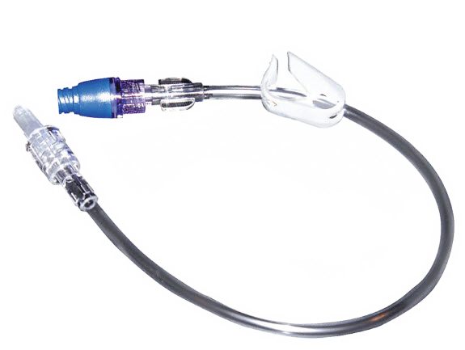
Tubing and Access
Tubing, injection ports, catheter entry
1. Use “closed” systems for infusion, blood draws & medication administration. | Closed systems used include: -Arterial lines: Hummi blood sampling device for UACs -Venous lines: Closed systems using needleless connector with alcohol cap at end to tubing being accessed. -Medication administration set-up: Components of all tubing remain attached when infant receiving medications. -All tubings other than Intralipids will be changed every 96 hours. Intralipid tubing changed every 24 hours.
2. Assemble and connect infusion tubing using aseptic technique. Tubing configured consistently for each type of VAD. | -Aseptic technique includes sterile barrier for tubing assembly & wearing of clean gloves.
3. Scrub needleless connector using friction with CHG/alcohol swab 10 times prior to line entry. Allow surface to dry prior to entry. Place alcohol cap after access. | -Place sterile 4x4 under site being accessed if in the infant’s bed. Change alcohol cap per manufacturer’s recommendations. Hub must still be scrubbed 10 times after removal of alcohol cap and allowed to dry.
4. Clean gloves for all VAD entries & hand hygiene utilized before & after glove use. | Standard precautions
5. Use pre-filled, flush containing syringes when necessary to flush catheter. | Manufacturer pre-filled normal saline or normal saline with heparin syringes used.
6. Staff empowered to stop non-emergent procedure if sterile technique not followed.
Notes:
Amy
Bundle Tubing and access

Slide 21
Administrative Leadership
Administrative Leadership | Considerations
1. Demonstrable administrative involvement in and support for achieving Zero Healthcare-Associated Infections
2. Engage Staff with feedback: -Posting days since last CLABSI -Posting CLABSI rates
3. Perform investigation and analysis of each CLABSI | -Begin process ASAP & within 24 hours of positive blood culture notification. Review opportunities for system improvements after each event.
4. Surveillance activities of critical processes related to sustaining the gains: a. Hand Hygiene b. Adherence to unit catheter management and entry standards c. Unit personnel support for the “Stop the Line” safety culture | a. Capture 50 HH observations/month/activity using consistent observers. b. As above initially, then smaller volume less frequently. c. Empower staff to stop intervention at any time when technique is being breached.
5. Competent trained personnel to perform specialized maintenance activities | -NNP/ MD will insert and maintain all catheter maintenance including dressing changes, repair and troubleshooting.
Notes:
AMY
Bundle Leadership

Slide 22

Tissue Adhesive Experience Outcomes
2020
2021
2022
93% of catheters removed at completion of therapy
88% of catheters removed at completion of therapy
1 migration
One mild skin abrasion (likely related to excess amount applied)
90% of catheters removed at completion of therapy
No migration
One CLABSI (long dwell time UA, tissue adhesive not re-applied)
One mild skin irritation (red after UA removal)
Tachycardia w/o migration
2 leaking EDIVs (new data collection method)
One skin issue, umbilical tape adhered to skin at stump
Notes:
Amy Do you have any data in 2023? One umbilical stump with delayed separation

Slide 23

Our CLABSI Journey
6
Pre-Collaborative
5
Practice Changes:
3.15% CHG/Alc at hub
CHG skin antisepsis greater than 1000gms
Alcohol-impregnated port covers implemented with 3.15% chg/alc scrub
4
3
Implementation of Tissue Adhesive
2
1
0
2007
2008
2009
2010
2011
2012
2013
2014
2015
2016
2017
2018
2019
2020
2021
2022
Notes:
AMY

Slide 24



Outcomes with tissue adhesive in NICU, Doctor’s Modesto, CA
95% without dislodgement
3 skin irritations: all on UCs where too much glue was applied & dripped to the tie
“Less is Better”
Only 8 dressing changes needed on PICC/ML
2 CLABSI: long-term (>7 days) UC did not receive re-application of glue : PICC dwell 12 days

Slide 25



Tissue Adhesive Experience
One difficult PICC removal: silicone-based
adhesive remover needed
Teaching moments on removal of a device with glue
Data collection
Forgetting application!
Temporary or traveling staff
Supply chain: CHG shortage
Notes:
AMY
One difficult PICC removal requiring adhesive remover (silicon-based)
Teaching moments for staff on removal of device with glue
Data collection
Forgetting application!
Supply chain: CHG shortage
Locum staff

Slide 26
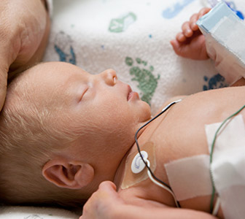
Born at 24 1/7 weeks, Birth weight 625 grams
Discharge diagnoses: RDS, ROP, IVH, growth failure
Case Study: Baby Z
CLINICAL CONCERNS
  ELBW
  Very immature skin
  2 PICCs and concerns for dressing integrity, having to remove the first PICC early
  No skin breakdown related to PICC dressing removals
  No skin breakdown related to UVC removal
VASCULAR ACCESS
  UA 8 days, tissue adhesive re-applied DOL #6
  UV 4 days, removal after PICC placement
  PICC #1, 3 days,
  removal for a cracked hub
  (unrelated to glue)
  PICC #2, 6 days, removal at the completion of therapy (TPN)
  No UA migration upon UVC removal
  No CLABSI, despite longer than ideal UA dwell
  Other risks associated with ELBW are extremely premature infant
Notes:
AMY
Born at 24 1/7 weeks, BW 625gms
Discharge diagnoses: RDS, ROP, IVH, growth failure
Vascular access:
UA 8 days, tissue adhesive re-applied DOL #6
UV 4 days, removal after PICC placement
PICC #1, 3 days, removal for cracked hub (unrelated to glue)
PICC #2, 6 days, removal at completion of therapy (TPN)
Clinical concerns:
ELBW
Very immature skin
2 PICCs and concerns for dressing integrity, having to remove the first PICC early
No skin breakdown related to PICC dressing removals
No skin breakdown related to UVC removal
No UA migration upon UVC removal
No CLABSI, despite longer than ideal UA dwell
Other risks associated with ELBW are extremely premature infant

Slide 27

Future Opportunities for TA Use
Consider cost- effectiveness
  Reduction of complication
  Fewer dressing changes
  Infection reduction
Not just the insertion site but dressing borders
Special considerations, including extremely fragile skin scenario (EB)
Notes:
Based on evidence, what changes do you anticipate at Doctors Modesto?

Slide 28

References:
Please scan the QR code for references
Adhezion Representative is available at vendor’s table

Slide 29
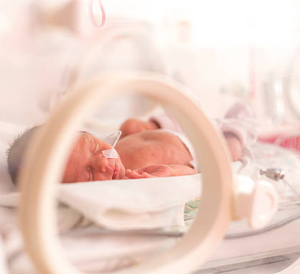
Questions
Notes:
COMMON QUESTIONS
How often to you change your central line dressings?
Do you still use an antimicrobial patch with the tissue adhesive?
Have you ever had a skin issue?
Do you have issues with pressure injuries?
What do you do if there is build up of glue?
Do you still suture your umbilical lines?
Do you reapply tissue adhesive when you remove one of the lines?
Do you need adhesive remover to remove the lines?
Do you use sterile adhesive remover?
Have you experienced breaks in any of your catheters?

